Slide 1

Layered testbench for D flip flop Pavithra.A PES2UG22EC804

Slide 2
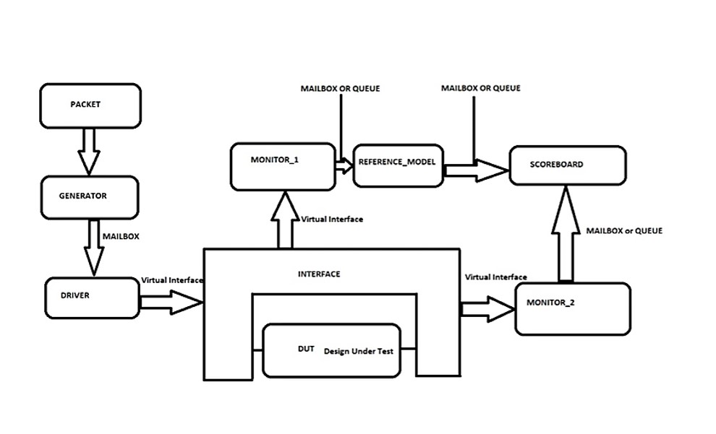
Testbench environment

Slide 3
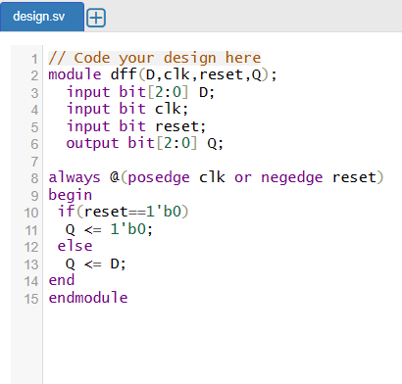
Design.sv https://www.edaplayground.com/x/EgWM * D flip flop has a single input D, and a clk and reset and output Q. * When the clock signal is low, the flip flop holds its current state and ignores the D input.When the clock signal is high, the flip flop samples and stores D input.The value that was previously fed into the D input is reflected at the flip flop’s Q output.If D = 0 then Q will be 0.If D = 1 then Q will be 1. D flip flop consist of a single input D and two outputs (Q and Q’). The basic working of D Flip Flop is as follows: D flip flop consist of a single input D and two outputs (Q and Q’). The basic working of D Flip Flop is as follows: D flip flop consist of a single input D and two outputs (Q and Q’). The basic working of D Flip Flop is as follows:

Slide 4
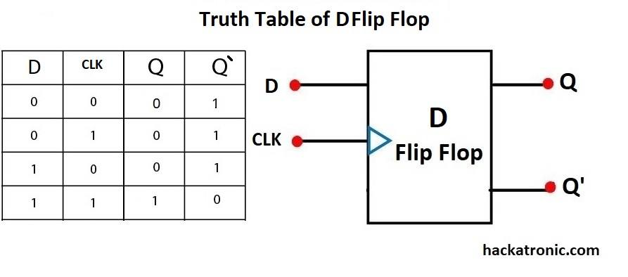

Slide 5
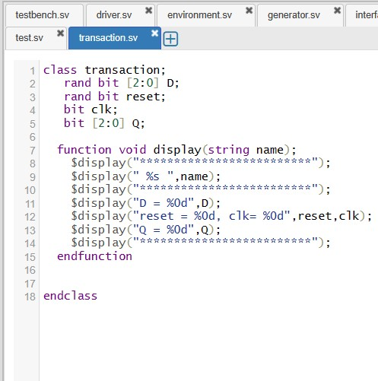
Packet class * In industries packet is reffered as transaction, and in this class we are randomizing the inputs and writing a function block to display inputs and outputs.

Slide 6
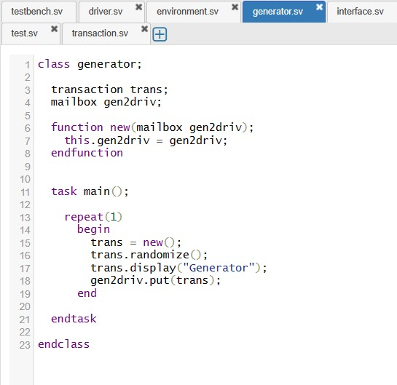
Generator class * The generator class will randomize the input signals. Now the randomized inputs are ‘put’into the mailbox using the put method. * Mailbox is used to communicate between classes, here gen2driv is handle for mailbox. * Keyword ‘virtual’ is used to connect static data type with dynamic data type. * There is a custom constructor here since it is flexible. *The keyword ‘this’ is used to refer class properties explicitly, to avoid the error when argument and property have same name.

Slide 7
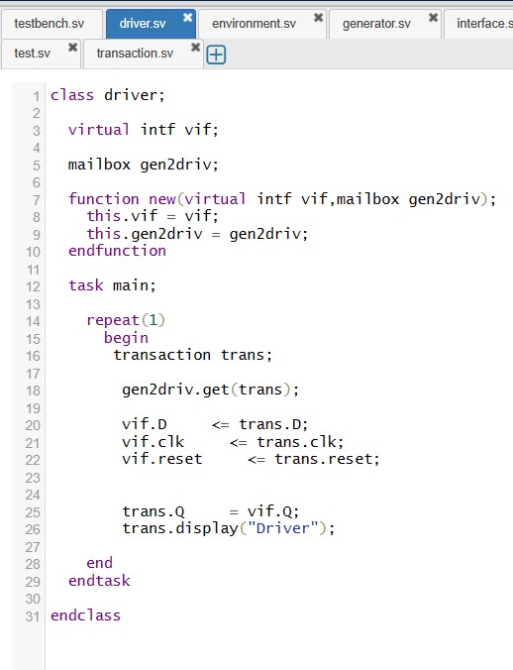
Driver class * The driver drives the stimulus into the DUT through interface. Interface is a buch of signals that connect DUT-RTL and TB-RTL. * In the driver class we are using ‘get’ method of mailbox, to communicate between classes. *Receives the stimulus (transaction) from a generator and drives inside the transaction (to DUT)

Slide 8
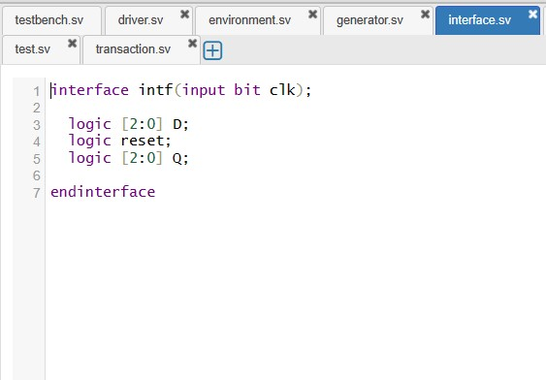
Interface class * It represents a bundle of nets or variables, which can do synchronization. It is used to connect to ports like a signal.

Slide 9
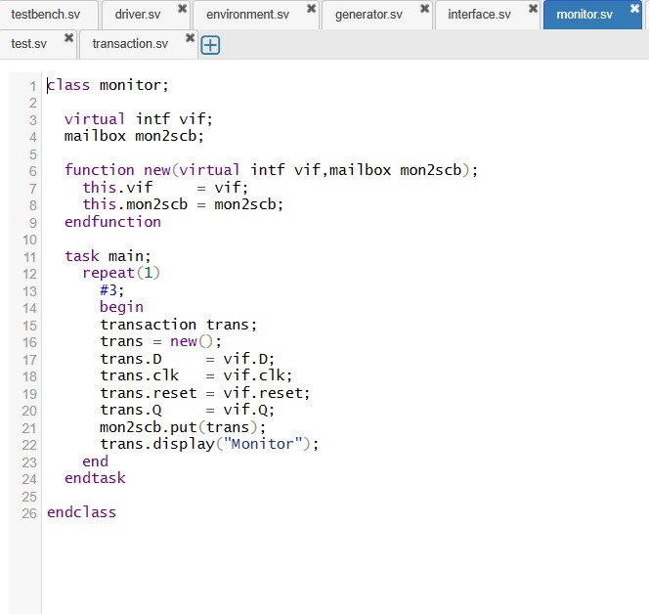
Monitor class * In the class monitor we are checking the inputs and outputs of the DUT. *We are using ‘virtual’ to connect static datatype with dynamic datatype. *We are declaring a mailbox, ‘mon2scb’ (monitor to scoreboard) and using ‘put’ method.

Slide 10
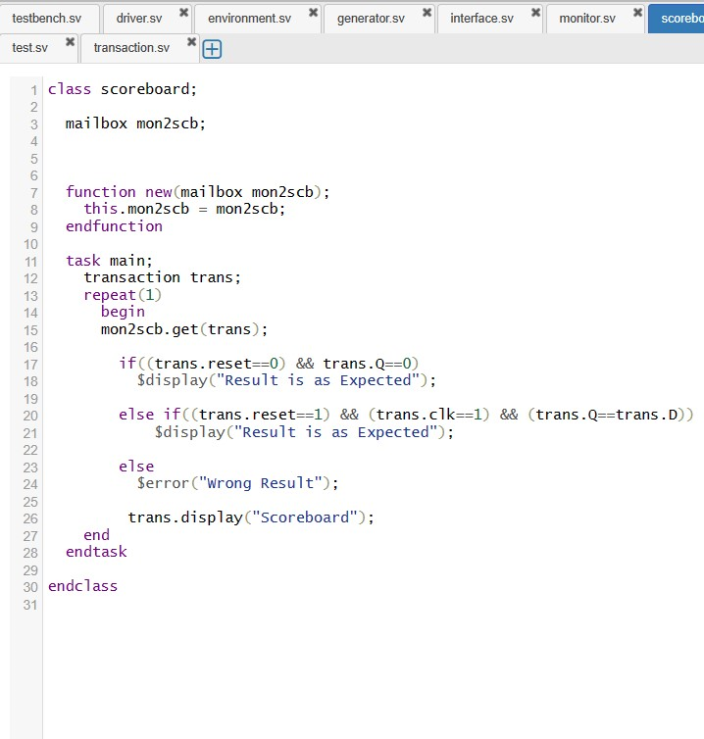
Scoreboard * Screboard is a comparator used to compare the output from reference module and DUT. * The reference model is sometimes written inside the scoreboard.

Slide 11
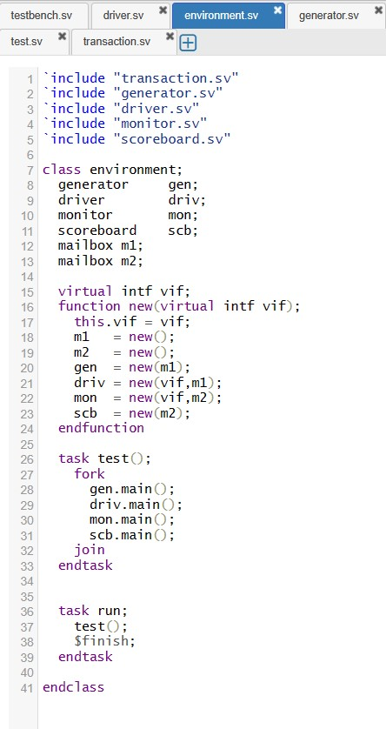
Environment class * The environment is a container class for grouping higher level modules.

Slide 12
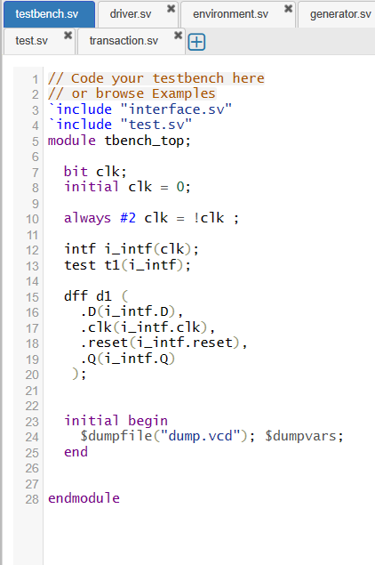
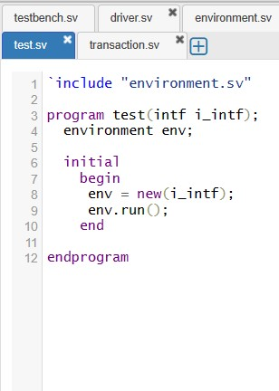
Testbench *This is the topmost file, which connects the DUT and TestBench. It consists of DUT, Test and interface instances, the interface connects the DUT and TestBench. Test.sv *The test is responsible for,Configuring the testbench Initiate the testbench components construction process Initiate the stimulus driving.

Slide 13
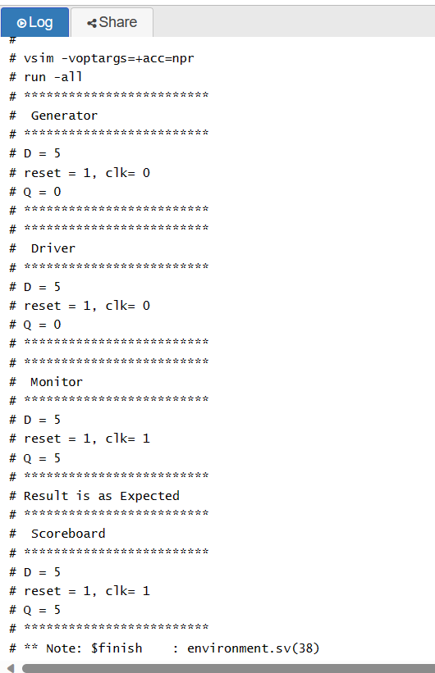
Output

